Slide 1
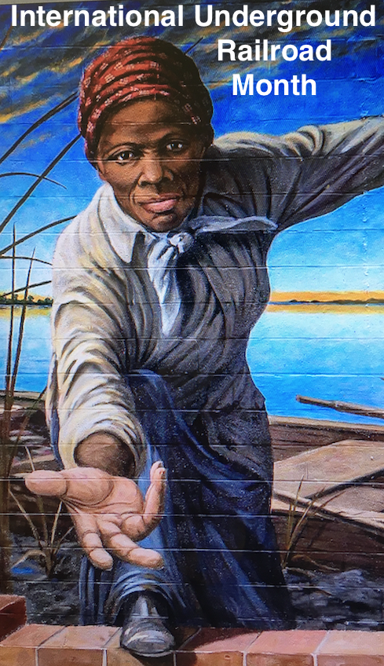

Slide 2
International Underground Railroad Month acknowledges the significance of the interracial Underground Railroad for its contribution to the eradication of slavery in the United States and as a cornerstone for the civil rights movement that continues today in the Black Lives Matter movement.
College Hill had an active community of abolitionists who were agents on the Underground Railroad. The well-documented “Escape of the 28” from Boone County, Kentucky in 1853 came through College Hill. The twenty-eight freedom seekers found refuge here and were safely transported by Black and White abolitionists on their journey to freedom in Canada. They were greeted in Canada by teacher, nurse, and abolitionist Laura Haviland and Henry Bibb, the editor of the first Black newspaper in Canada, the Voice of the Fugitive.
Our exhibit honors the courageous stories of those who emancipated themselves from slavery, the stories of the Black and White abolitionists who aided them, and the people who documented, interpreted and shared these stories from the Underground Railroad. We see that this journey continues today. Black and White residents of College Hill are creating new stories as they “Line the Avenue” every Sunday from 5-6 to show that when Black Lives Matter, then all lives can matter.

Slide 4
“ History is not the past. It is the present. We carry our history with us. We are our history”
James Baldwin

Slide 5
This exhibit is sponsored by
National Park Services: National Underground Railroad Network to Freedom The Ohio Humanities Council
The College Hill Historical Society HamiltonAvenueRoadToFreedom.org
Photo credits
Harriet Tubman: Courtesy of Maryland Department of Commerce Office of Tourism
Laura Haviland and historical posters: Courtesy of the Bentley Historical Museum
Henry Bibb: Courtesy of National Portrait Gallery
The Underground Railroad: (Charles T. Webber) courtesy of Cincinnati Art Museum
Black Lives Matter Mural photo: Urban League of Greater Cincinnati
Photo Credits: Tim Kraus, Diana Porter, Blanche Pringle Smith

Slide 6
Notes:
This is the route of the Escape of the 28 through College Hill

Slide 8
Notes:
24 x 36 reproduction of Charles Webber’s The Underground Railroad Levi and Katie Coffin are pictured here

Slide 9
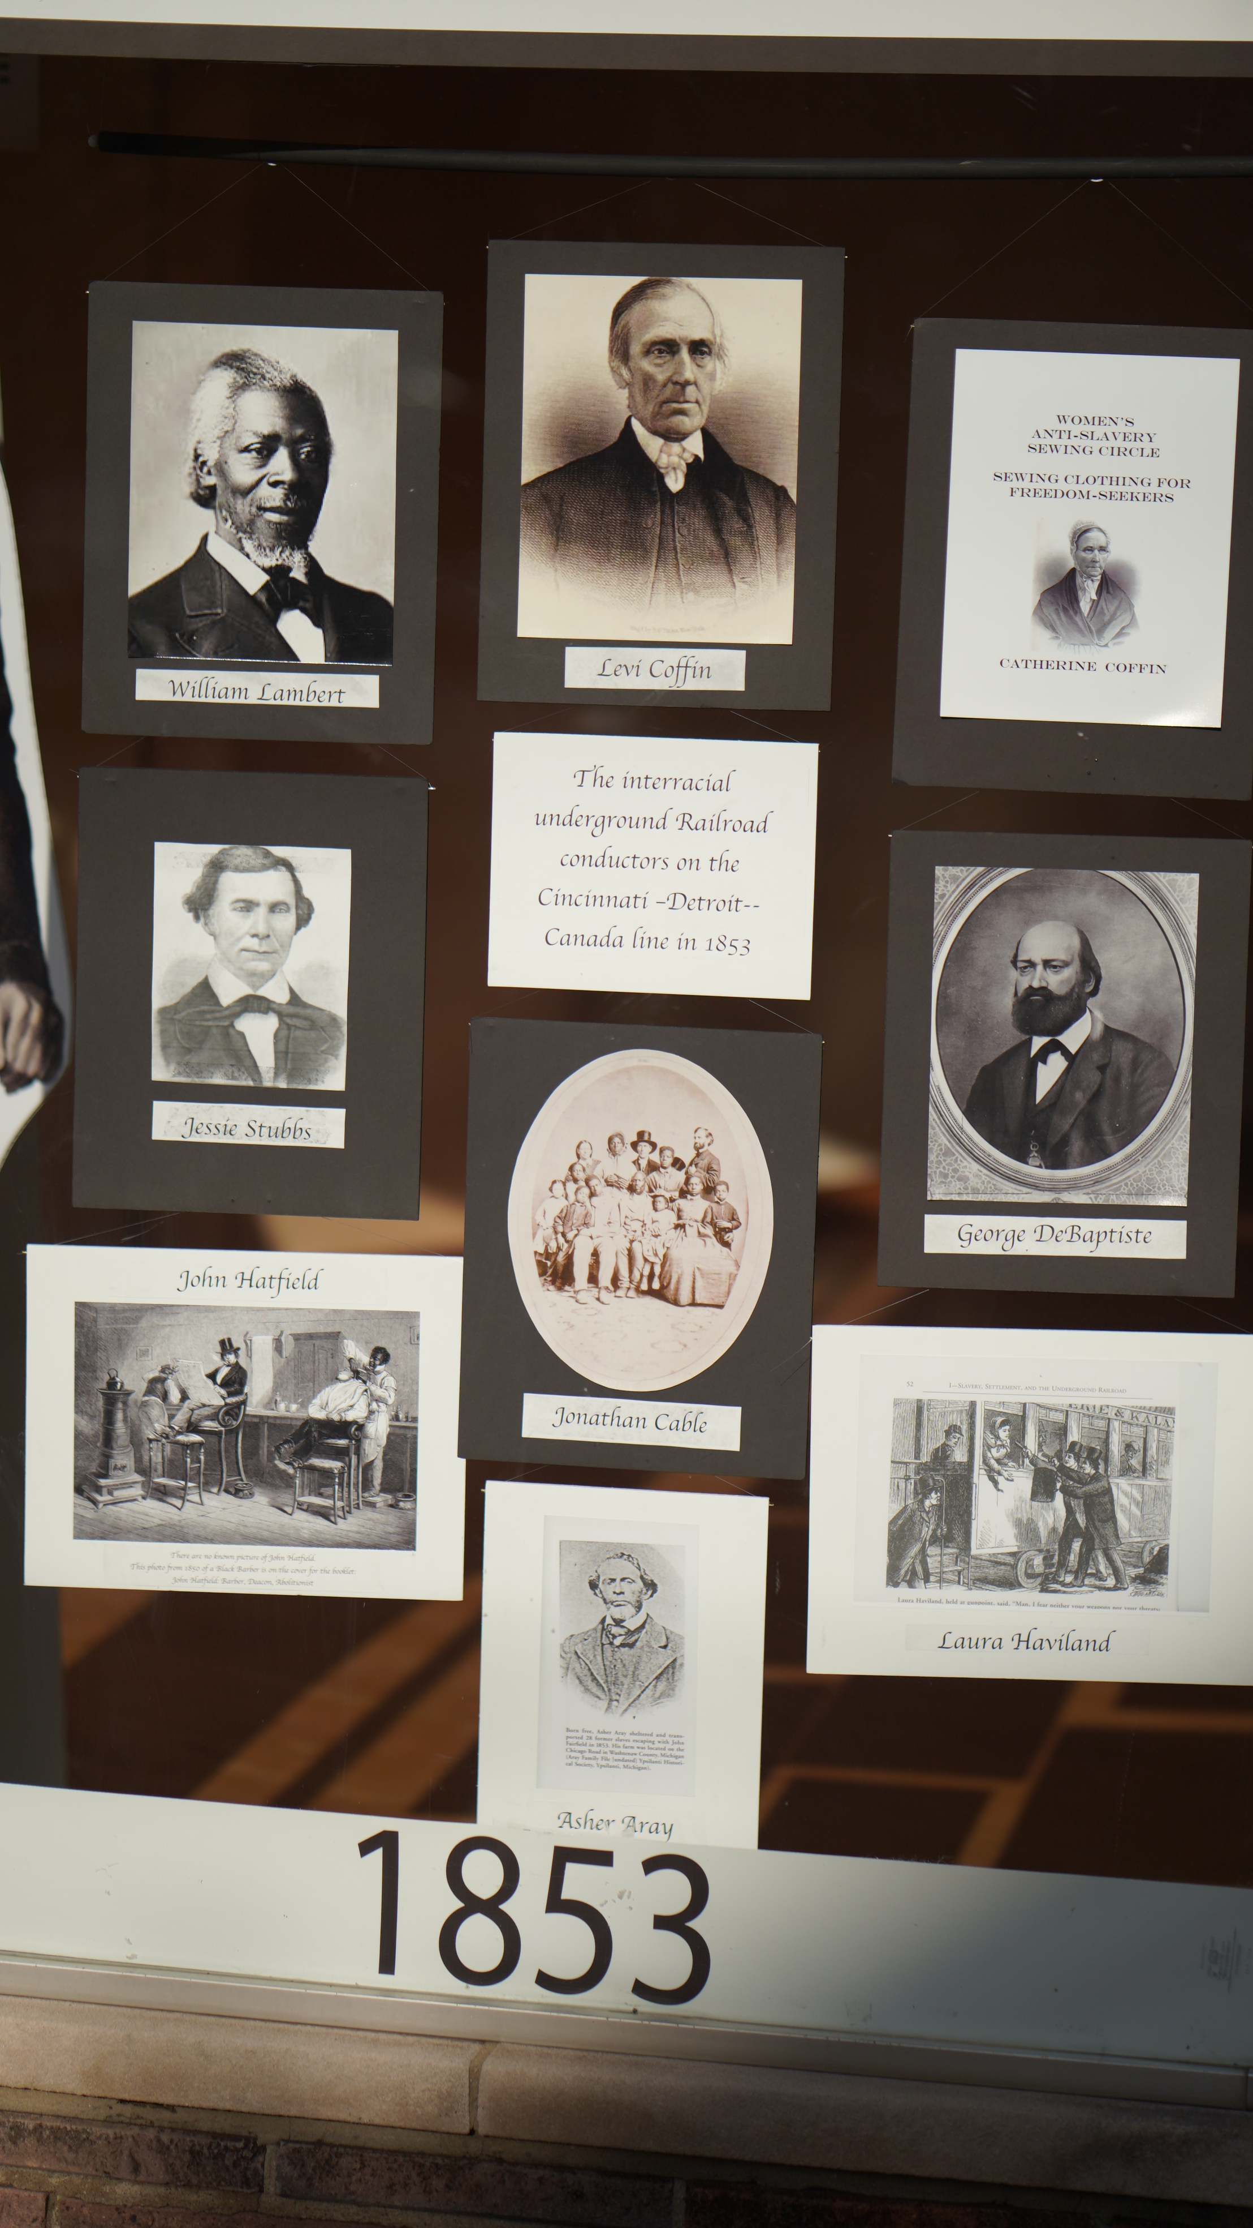
Notes:
The interracial UGRR conductors on the Cincinnati-Detroit line

Slide 10
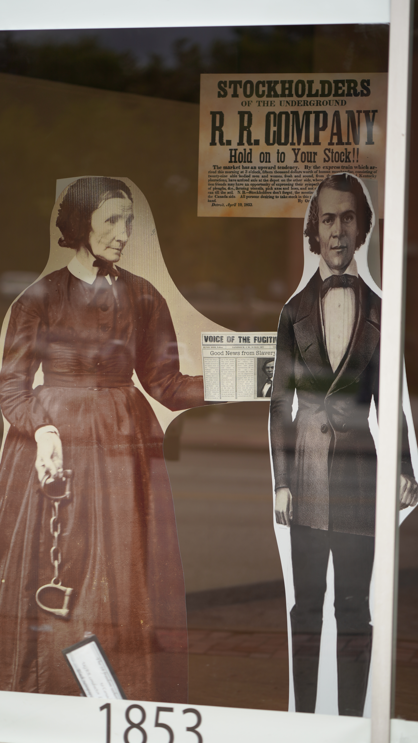
Notes:
Life Size Cut-outs of Laura Haviland and Henry Bibb who greeted the 28 on their arrival in Canada

Slide 11
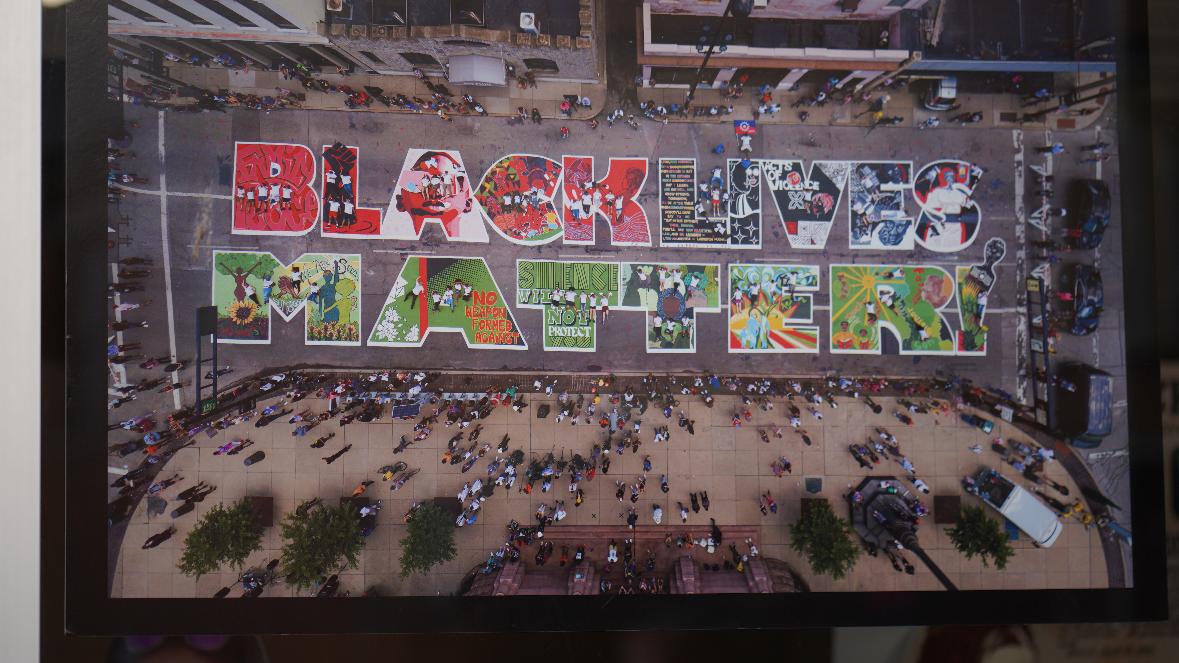
Notes:
24 x 36 photo of the Black Lives Matter Mural in fron of Cincinnati City HAll

Slide 12
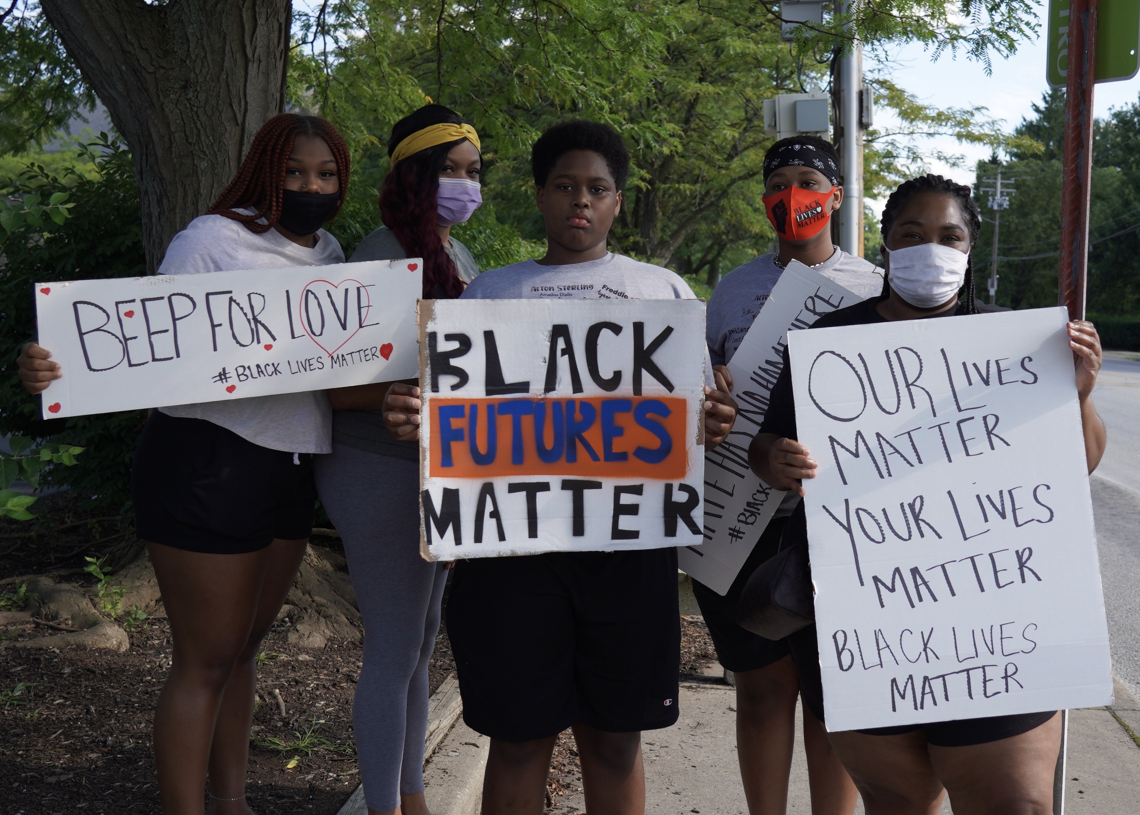
Notes:
8 x 10 Photos of Line the Avenue

Slide 13
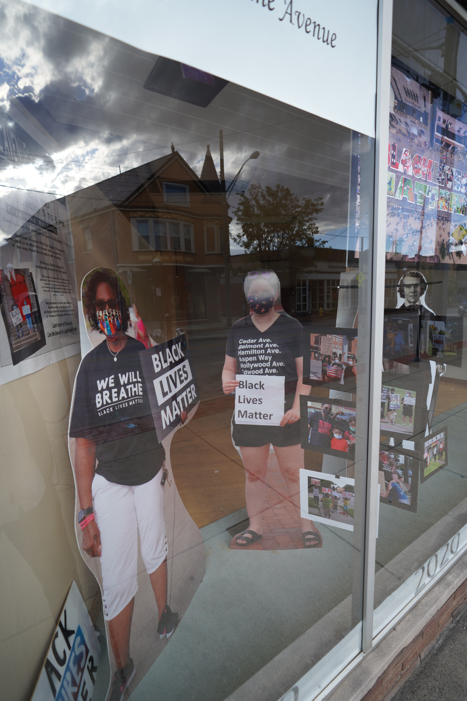
Notes:
Two life size cut outs of College Hill residents

Slide 14
Notes:
24 x 36 inch poster for the College Hill Line the Avenue event each SUnday

Slide 15
Notes:
8 x 10 photo of Line The Avenue in College Hill

Slide 16
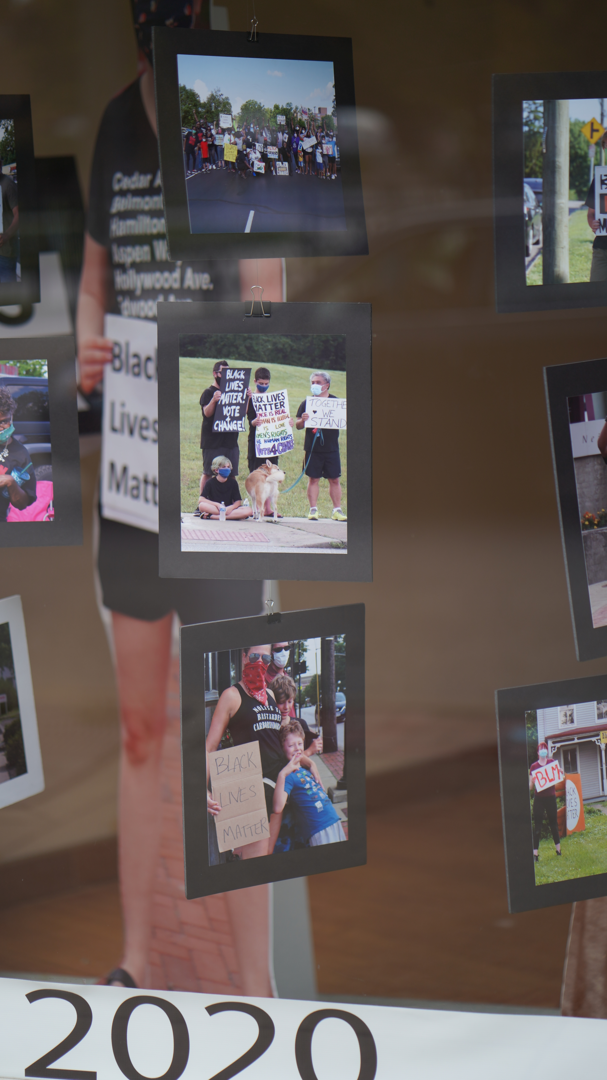
Notes:
We have over 20 pictures from the weekly Black Lives Matter Support event every Sunday since June, 2020. some were hung under the BLM mural from Cincinnati City Hall. This is a very flexible part of this exhibit.

